Slide 1
Mountain View Community Hospital
DBMS Report – April 2016

Slide 2
System Requirements/Problem Definition
Support for recording and reporting medical procedure results.
On-line processing.
Revenue by cost department tracking/reporting.
Support for future changes and expansion.
Retain previous system functionality.
Mission Statement:
This new proposed system for MVCH will replicate the operations of the previous system while expanding the capabilities to allow instant custom data entry and retrieval, management of specific resources, the creation of flexible reports, and room for future scalability.
This system will be a relational database management system developed through the standard DBLC.

Slide 3
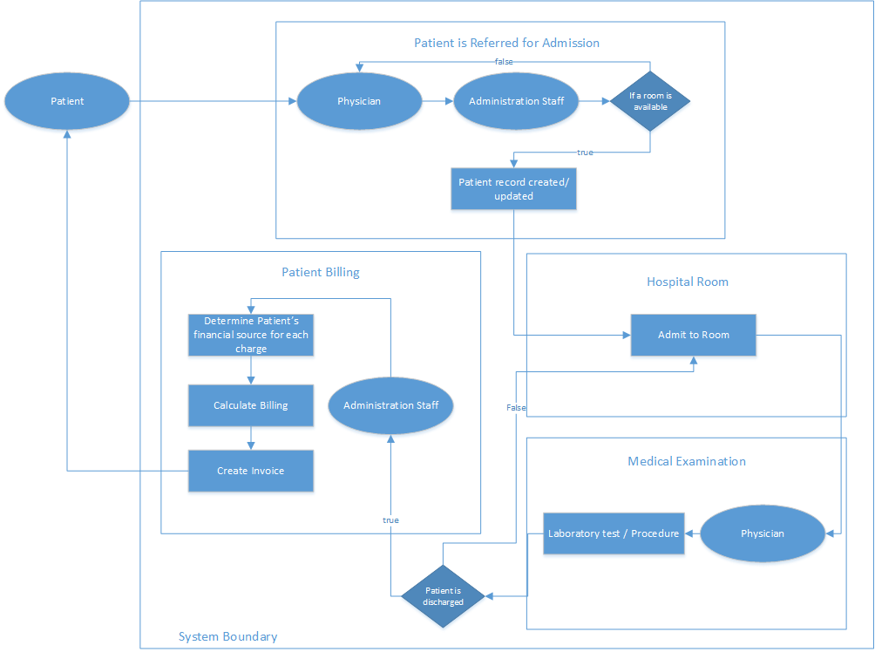
System Boundary
This diagram depicts the process of patient admission through physician referral.

Slide 4
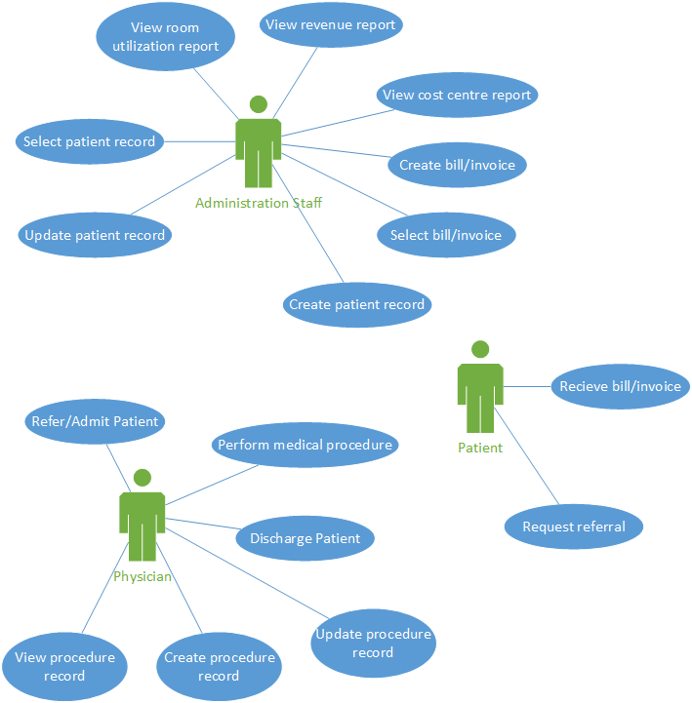
Use Case
The diagrams depict the process that each of the main actors can perform within this system.
Physician – referral and discharge of patients, medical records.
Administration – Billing, revenue reports, and patient records.
Patients – Receive billing records and request referral.

Slide 5
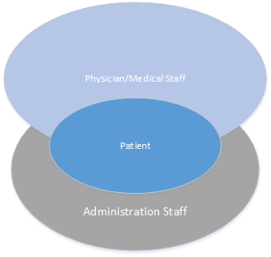
User Views
This diagram depicts the restriction of data based on actor type within the system. Medical staff will have access to patient records excluding billing and access to procedure records. Administration staff will have access to billing, revenue, and patient records excluding specific medical information.

Slide 6
Tables and attributes
PATIENTS PATIENT_ID, PATIENT_NAME, PATIENT_ADDRESS, PATIENT_CITY, PATIENT_PROV, PATIENT_POSTAL_CODE, PATIENT_PHONE_NUMBER, GENDER, HCN, FINANCIAL_STATUS
LOCATION_ADMITTED PATIENT_ID, LOCATION_ID, DATE_ADMITTED, BILL_ID, DISCHARGE_DATE
PHYSICIANS PHYSICIAN_ID, PHYSICIAN_NAME, PHYSICIAN_PHONE_NUMBER, SPECIALTY
PATIENTS_REFERRED PHYSICAN_ID, PATIENT_ID,
ROOMS LOCATION_ID, ROOM_TYPE, EXTENSION
PATIENT_BILLS BILL_ID, BILL_DATE, BALANCE_DUE
SERVICES_CHARGED BILL_ID, ITEM_ID, DATE_CHARGED, QUANTITY, FINANCIAL_SOURCE
ITEMS ITEM_ID, COST_CENTRE_ID, ITEM_DESCRIPTION, ITEM_CHARGE
COST_CENTRE COST_CENTRE_ID, COST_CENTRE_NAME

Slide 7
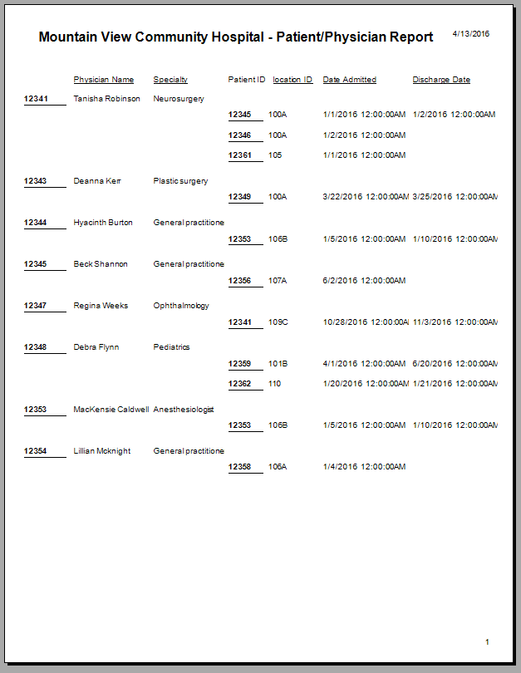
Sample Reports

Slide 8
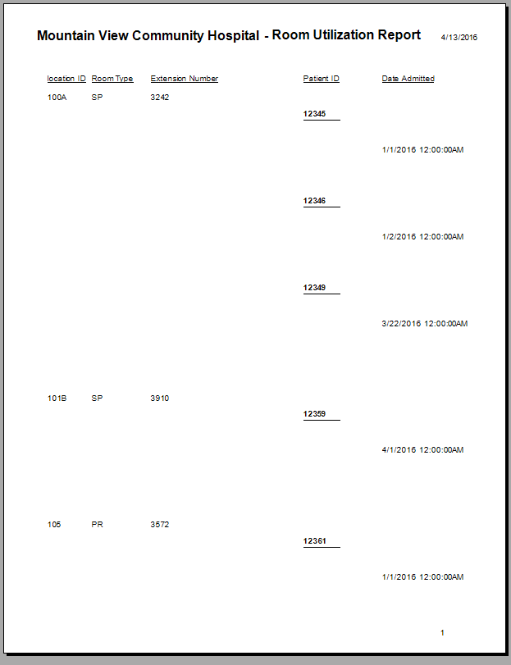
Sample Reports (cont'd)

